Slide 1

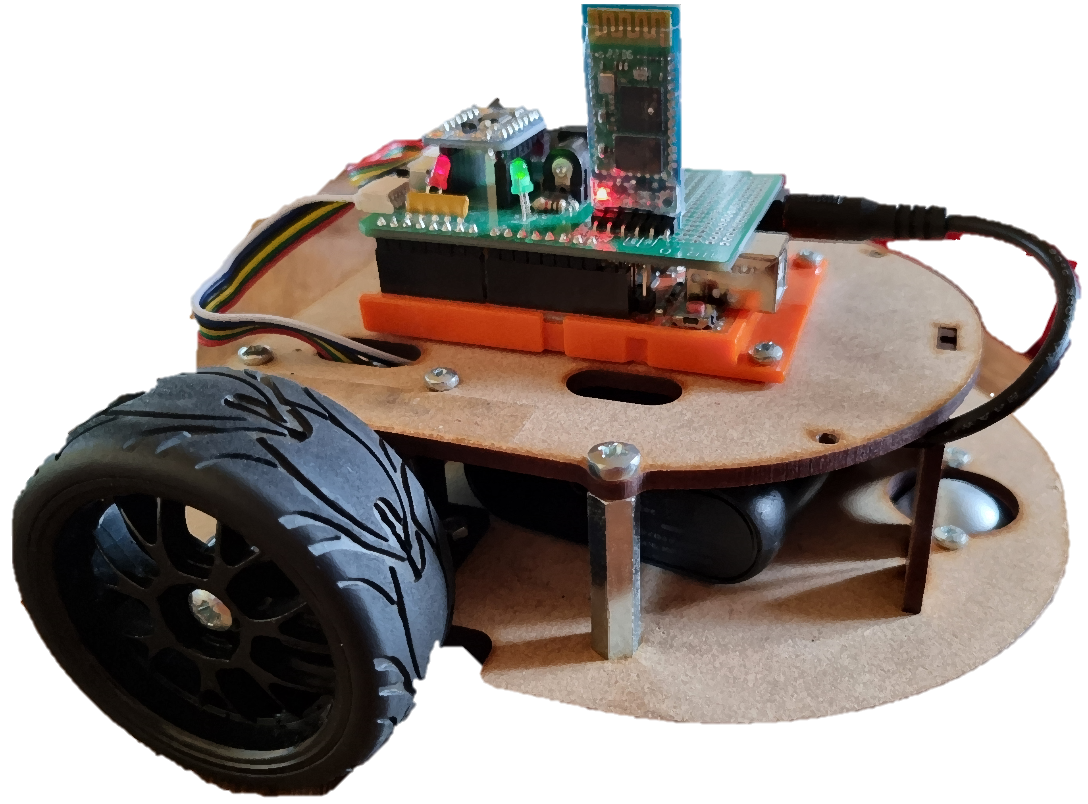
An Intelligent Robot using a Smartphone camera
By: Mikhaela Roy M00704717
Supervisors: Dr Tao Geng and Nick Weldin

Slide 2
Background Research

Slide 3
Aims
Basic Objectives | Achieved
Ball Detection Feature Identification Colour Detection
Connection Computer and Smartphone Computer and mobile robot
Distance between object and device
Reduce latency
Personal Objectives | Achieved
Differentiate between objects
App Development

Slide 4
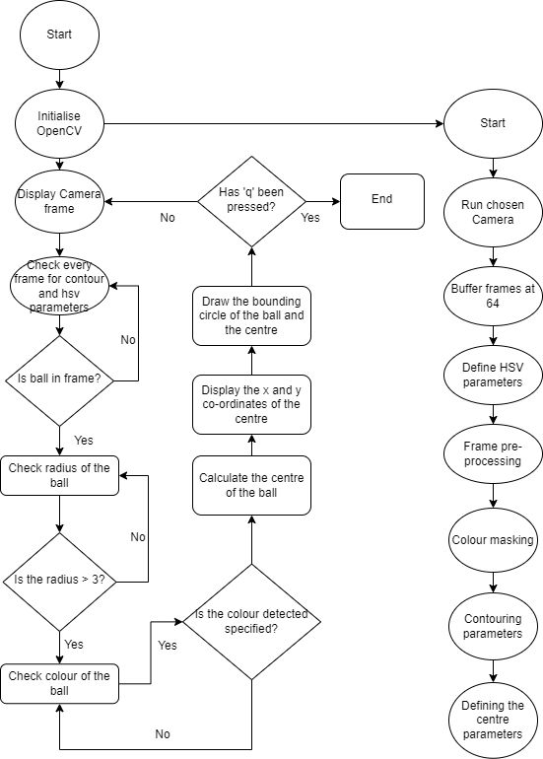
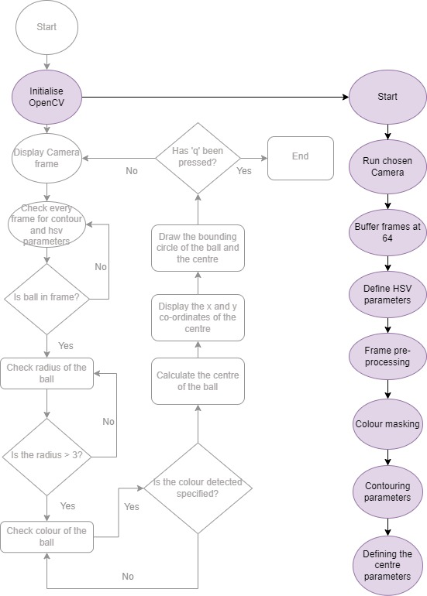
Flowchart for Ball Tracking

Slide 5
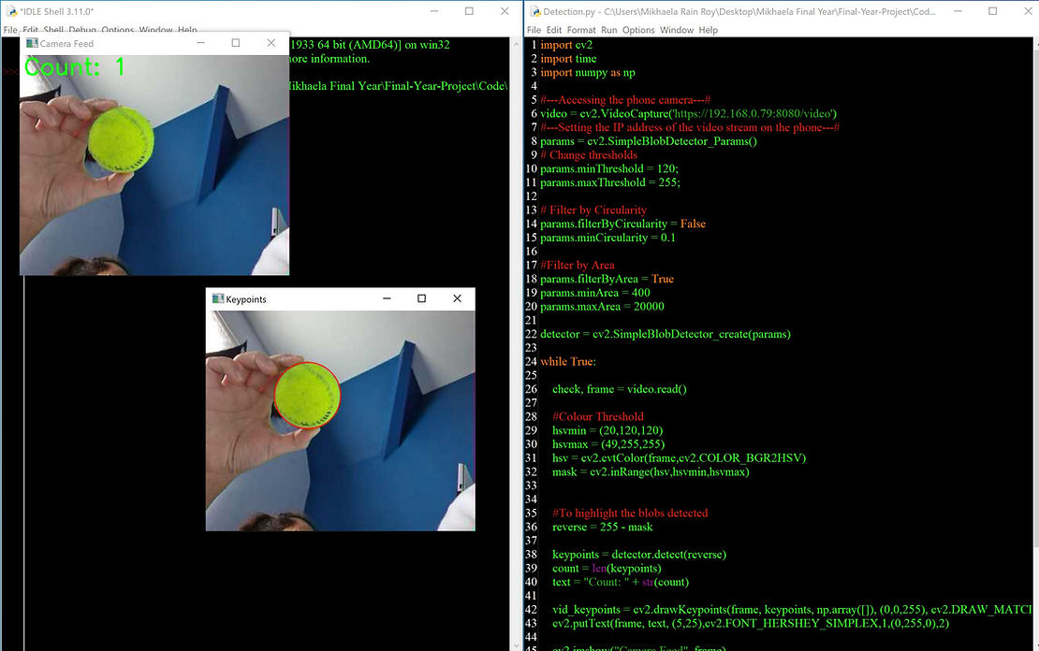

Blob Detection VS Ball Tracking
If possible change to a video
Notes:
Ball Tracking:
Combination of contouring and colour masking from OpenCV
Why?
Accurate tracking
(X, Y) co-ordinates calculated
Any lighting conditions
Quick colour detection
Feature Identification
No background interference
Low computational load
Blob Detection:
Simple Blob Detection, pre-made algorithm by OpenCV
Pros:
Simple program
Quick colour detection
Low computational load
Pixel based area
Cons:
Unable to differentiate similar sized objects
Background affects detection
Colour based (HSV)
Lighting conditions must be consistent

Slide 6
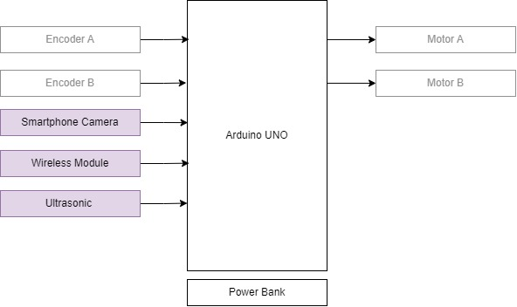
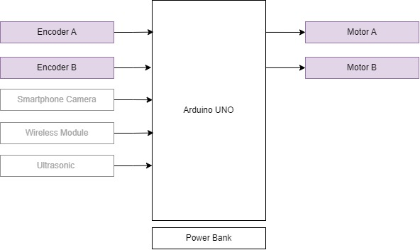
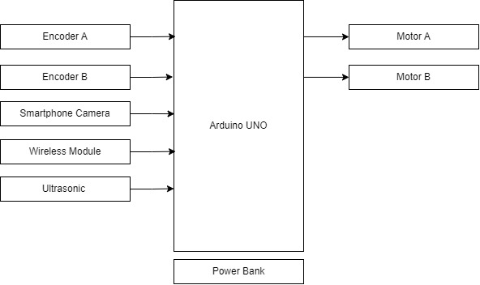
Electronics: Block Diagram
Notes:
Calculate the pixel size in the bounding circle to determine distance
Do all calculation in python
Complete motor commands in Arduino
Complete Bluetooth connections.

Slide 7
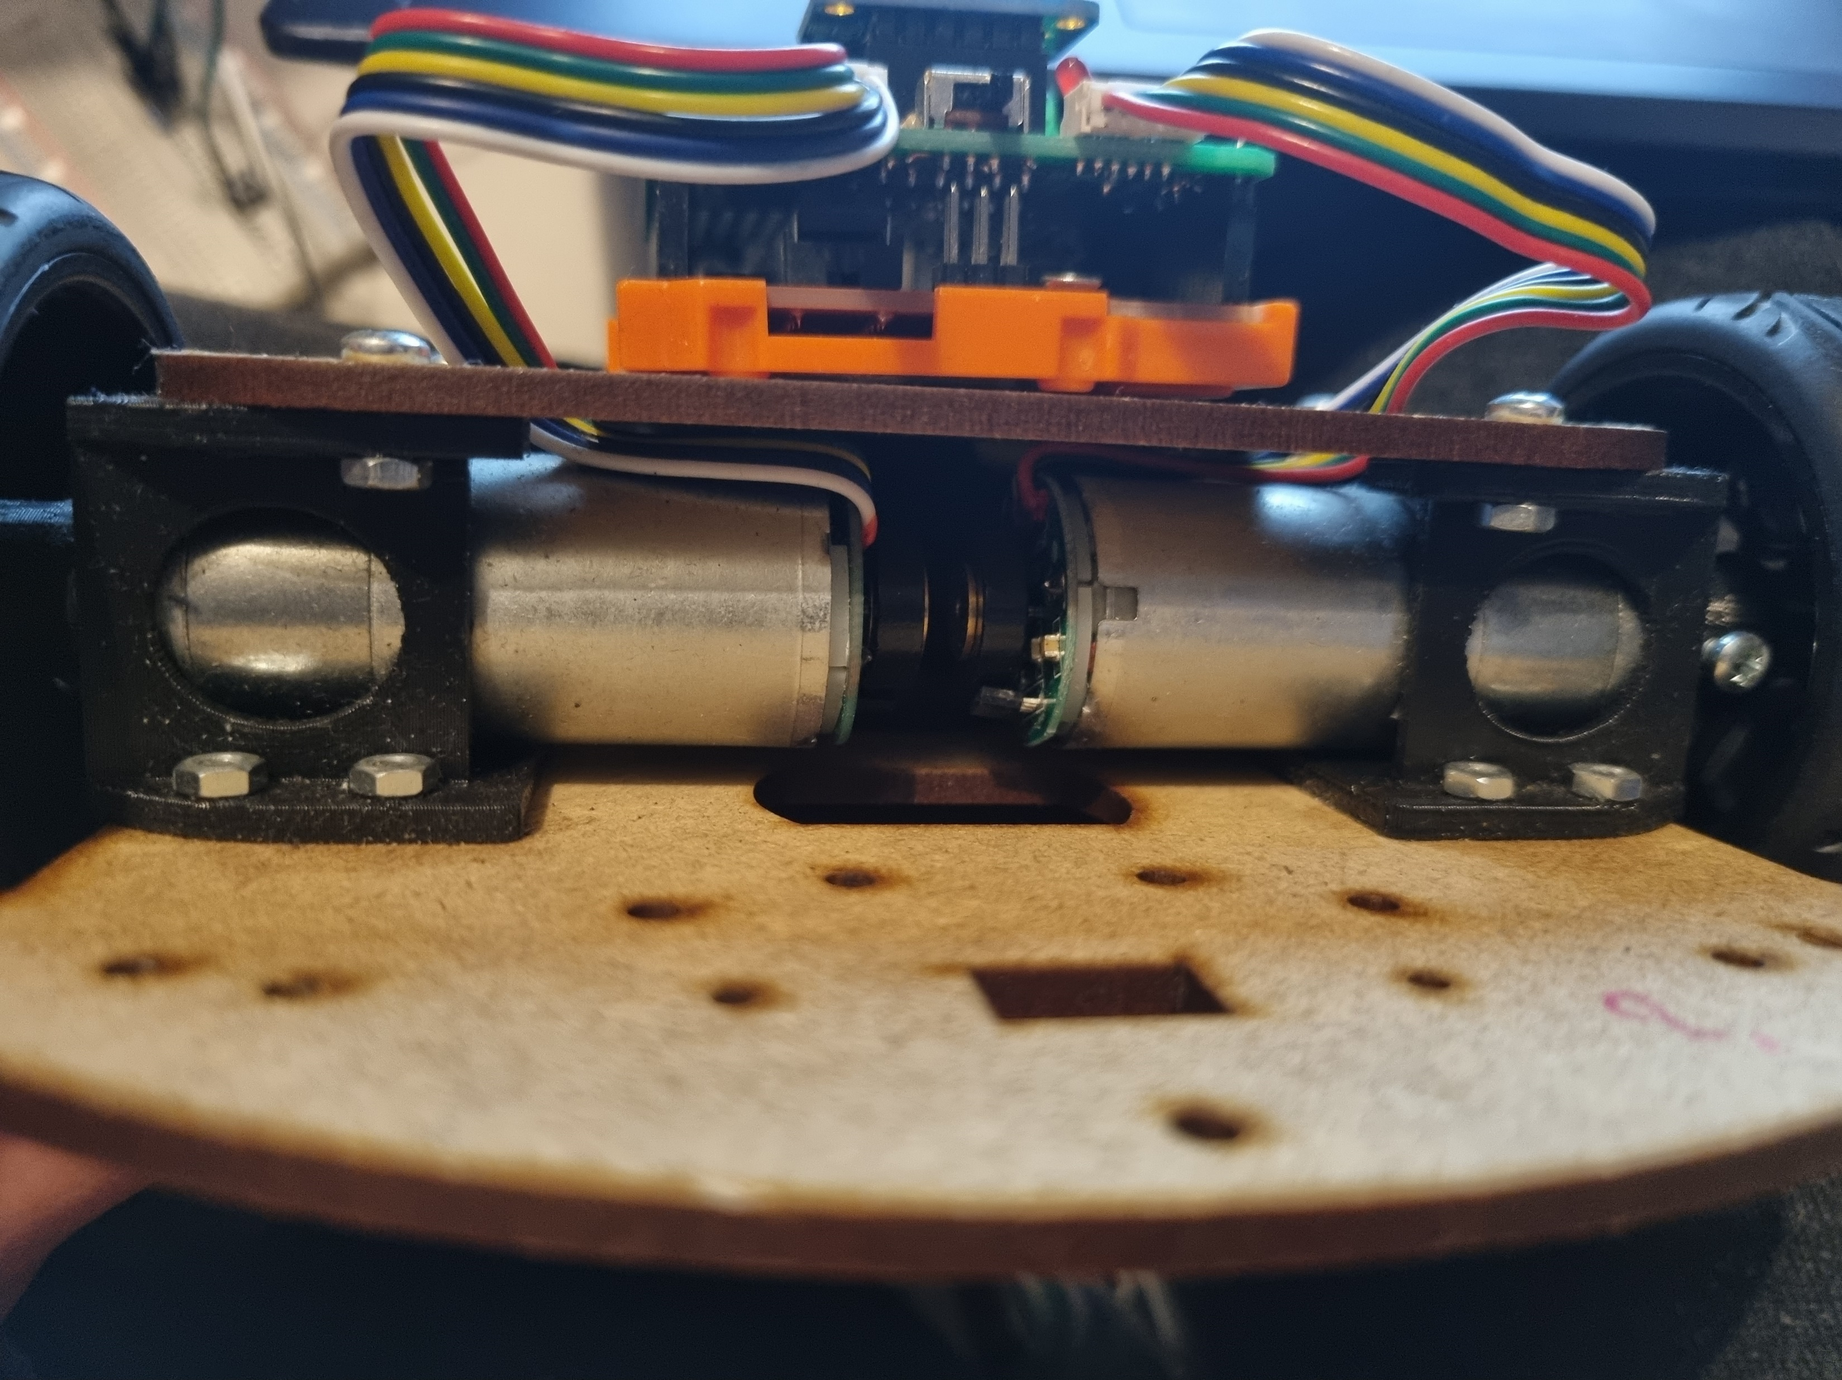
Electrical Components
Bluetooth Module
Motor Driver
Proto Shield
Wheel A/B connectors
Hall effect Encoders
Power bank
Update system once smartphone has been attached

Slide 8
Motor Control
[INSERT IMAGE/VIDEO OF MOTOR CONTROL]
fadf

Slide 9


Future Development
Basic Objectives | Achieved
Ball Detection Feature Identification Colour Detection
Connection Computer and Smartphone Computer and mobile robot
Distance between object and device
Reduce latency
Personal Objectives | Achieved
Differentiate between objects
App Development
Allow for advanced differentiation between objects
App development to access various sensors on the smartphone directly

Slide 10
Thank you for listening
Any Questions?
☺

Slide 11
Ball detection and tracking methods

Slide 12
Haar Cascade

Slide 13
Hough Circle

Slide 14
Motor Control Methods

